Slide 1
Operating System
Lecture #6
Process Management

Slide 2
Objectives
Cooperating and Independent Processes
Inter process communication
Process Management in Unix
Threads

Slide 3
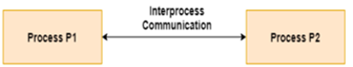
Inter Process Communication
Interprocess communication is the mechanism provided by the operating system that allows processes to communicate with each other.
This communication could involve a process letting another process know that some event has occurred or the transferring of data from one process to another.

Slide 4
Inter Process Communication
Processes executing concurrently in the operating system might be either independent processes or cooperating processes.
Cooperating Process in the operating system is a process that gets affected by other processes under execution or can affect any other process under execution.
An independent process in an operating system is one that does not affect or impact any other process of the system.

Slide 5
Cooperating processes
It shares data with other processes in the system by directly sharing a memory or by sharing data through files or messages.
Cooperating processes in OS requires a communication method that will allow the processes to exchange data and information.
There are two methods by which cooperating process in OS can communicate:
Cooperation by Sharing
Cooperation by Message Passing

Slide 6
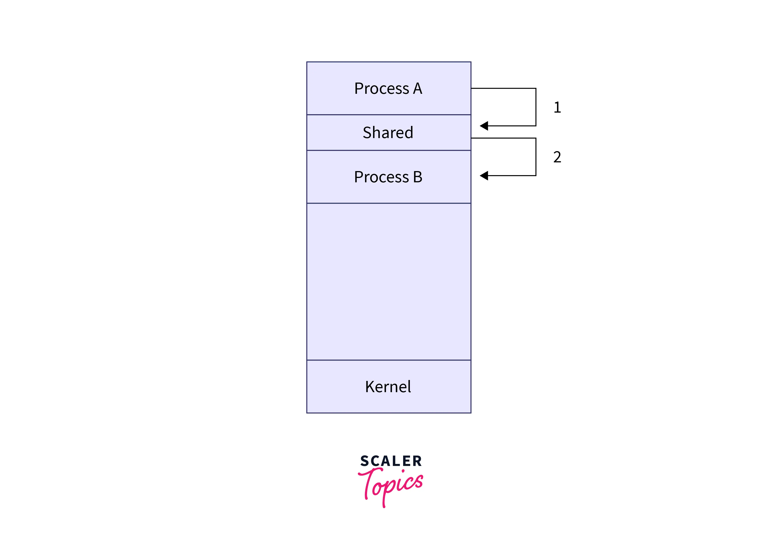
Cooperation by Sharing
The cooperation processes in OS can communicate with each other using the shared resource which includes data, memory, variables, files, etc.
Processes can then exchange the information by reading or writing data to the shared region. We can use a critical section that provides data integrity and avoids data inconsistency.

Slide 7
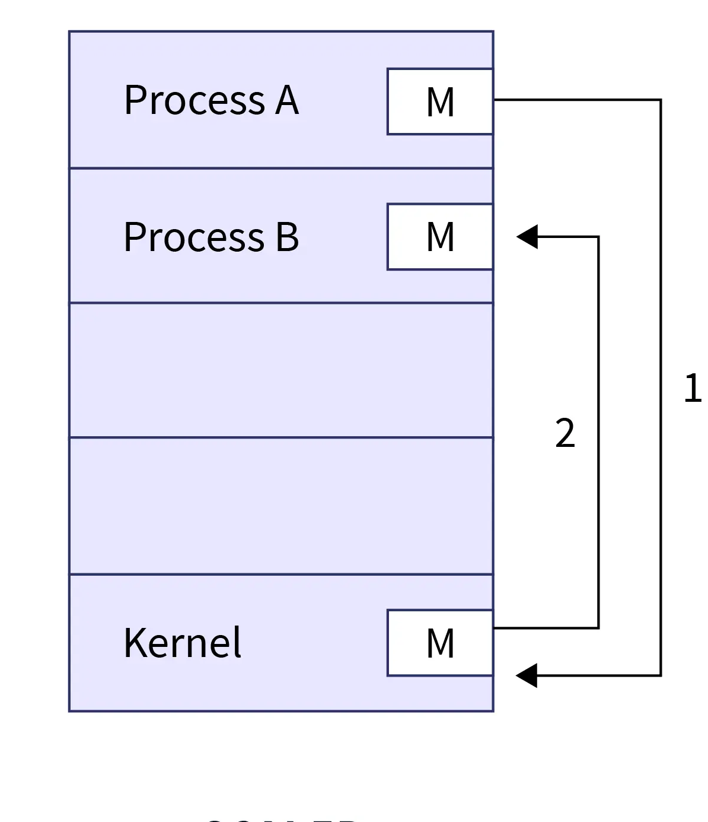
Cooperation by Memory
The cooperating processes in OS can communicate with each other with the help of message passing. The production process will send the message and the consumer process will receive the same message.
There is no concept of shared memory instead the producer process will first send the message to the kernel and then the kernel sends that message to the consumer process.

Slide 8
Task
Explore the difference of Message passing and shared memory.

Slide 9
Inter Process Communication
To send and receive messages in message passing, a communication link is required between two processes. There are various ways to implement a communication link.
Direct and indirect communication
Synchronous and asynchronous communication
Buffering

Slide 10
Direct communication
In direct communication, each process must explicitly name the recipient or sender of the communication.
send(P, message) – send a message to process P receive(Q, message) – receive a message from process Q
Link is always created between two processes.
One direct link can be used only between one pair of communicating processes.
Two processes can use only a single direct link for communication.

Slide 11
Indirect communication
In indirect communication, messages are sent and received through mailboxes or ports.
send(A, message) – send a message to mailbox A receive (A, message) – receive a message from mailbox A
Different pair of processes can use the same indirect link for communication.
Also, two processes can two different indirect links for communication.

Slide 12
Synchronous and asynchronous communication
Message passing may be blocking (synchronous) or non blocking (non-synchronous)
Blocking send – blocks the sending process until the receiving process receives the message. This means that the sending process will not send data until the receiving process is also there. For example, in a class, the teacher will not speak until there are students sitting to receive.
Non blocking send – the sending process sends the message and resumes operation. Hence, the sending process does not bother whether the receiver is there or not.

Slide 13
Synchronous and asynchronous communication
Blocking receive – the receiver blocks until a message is available. This means that the receiving process will not proceed until the sending process is not there. For example, in a class, the students do not go until the teacher comes and delivers the lecture.
Non blocking receive – The receiver process does not wait for the sender to send data. Hence, the receiver retrieves either a valid message or NULL.

Slide 14
Buffering
The speed of the sender and receiver process can be different. So, it is important to introduce some kind of temporary storage. For example, if your internet connection is slow, the video in youtube gets buffered. The messages exchanged by the communicating process reside in a temporary queue. There are three ways to implement queues.
Zero capacity buffer – it means that there is no buffering in the system. If the receiver is slow, then the data will be lost.
Bounded buffer – means that the memory used for buffering has a bound to it. Hence, you can not buffer unlimited data.
Unbounded buffer – if there is unlimited memory available for buffering.

Slide 15
Inter Process Communication
The different approaches to implement interprocess communication are given as follows −
Pipe
A pipe is a data channel that is unidirectional. Two pipes can be used to create a two-way data channel between two processes. This uses standard input and output methods.
Socket
The socket is the endpoint for sending or receiving data in a network. This is true for data sent between processes on the same computer or data sent between different computers on the same network. Most of the operating systems use sockets for interprocess communication.
File
A file is a data record that may be stored on a disk or acquired on demand by a file server. Multiple processes can access a file as required. All operating systems use files for data storage.

Slide 16
Inter Process Communication
Signal
Signals are useful in interprocess communication in a limited way. They are system messages that are sent from one process to another. Normally, signals are not used to transfer data but are used for remote commands between processes.
Shared Memory
Shared memory is the memory that can be simultaneously accessed by multiple processes. This is done so that the processes can communicate with each other.
Message Queue
Multiple processes can read and write data to the message queue without being connected to each other. Messages are stored in the queue until their recipient retrieves them. Message queues are quite useful for interprocess communication and are used by most operating systems.

Slide 17
Any Query??

